Slide 1

Does Money Buy Happiness?
Using Data to reveal Happiness correlations with relevant factors
Storyteller: Razvan N.
This Photo by Unknown Author is licensed under CC BY
Notes:
Ever since the modern human existed, he was in a permanent pursuit of Happiness. And one of the biggest question asked when it comes to Happiness is "Does Money Buy Happiness?“
The intended audience for this story presentation is the Internet. I choose it because I want the presentation to be one focused on the findings and not on the technical procedures or business or financial impact of my findings.

Slide 2
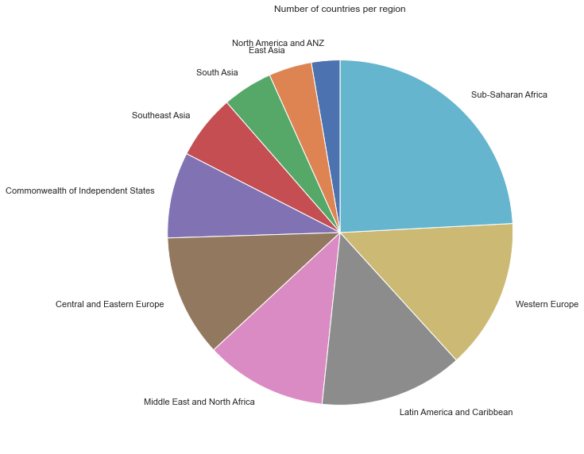
Show me the Data
The collected data originates from The World Happiness Report. This is a landmark survey of the state of global happiness.
It contains 149 countries from 10 regions in 6 different continents.
Presented data is gathered for the year of 2021
Notes:
The World Happiness Report is a landmark survey of the state of global happiness. The report continues to gain global recognition as governments, organizations and civil society increasingly use happiness indicators to inform their policy-making decisions. Leading experts across fields – economics, psychology, survey analysis, national statistics, health, public policy and more – describe how measurements of well-being can be used effectively to assess the progress of nations. The reports review the state of happiness in the world today and show how the new science of happiness explains personal and national variations in happiness.(Kaggle Dataset Description)

Slide 3

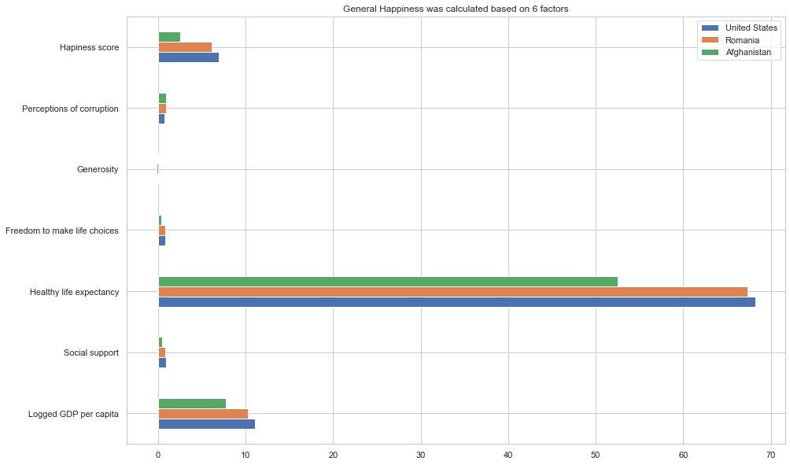
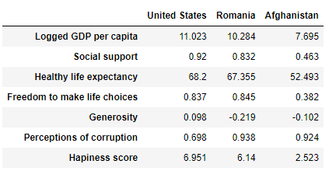
The Happiness score was calculated out of six factors:
economic production
social support
life expectancy
freedom
absence of corruption
generosity
What Makes Us Happy?
Notes:
The happiness scores and rankings use data from the Gallup World Poll. The columns following the happiness score estimate the extent to which each of six factors – economic production, social support, life expectancy, freedom, absence of corruption, and generosity – contribute to making life evaluations higher in each country than they are in a hypothetical country that has values equal to the world’s lowest national averages for each of the six factors.

Slide 4
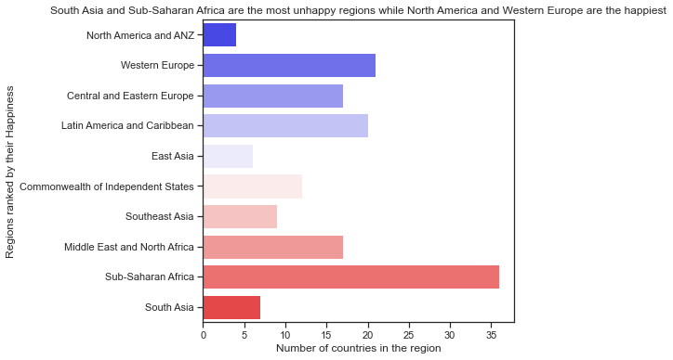
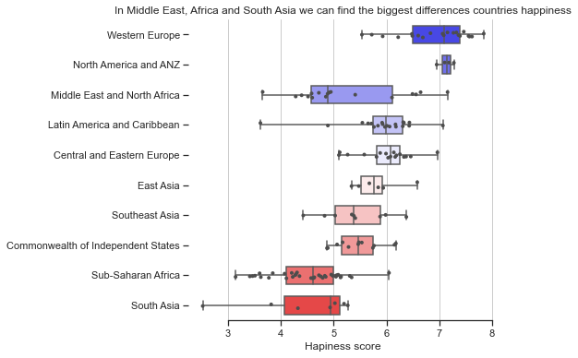
Big Happiness Differences exists not only between different regions, but also among countries from the same region.

Slide 5

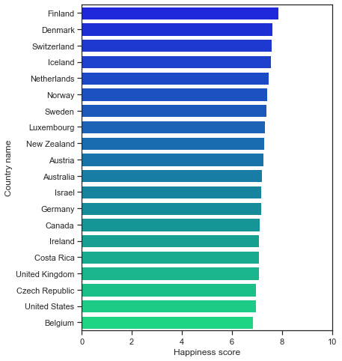
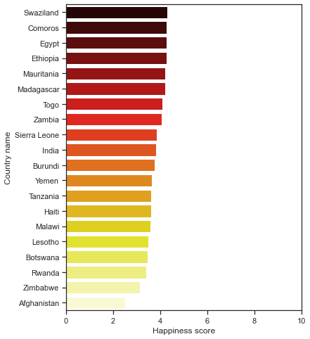
But when it comes to most happy countries and least happy countries, we can see the big gap between Europe and Africa
We know there are several causes that can determine the Happiness levels, so let’s see which of the factors discussed here have the highest correlation.

Slide 6
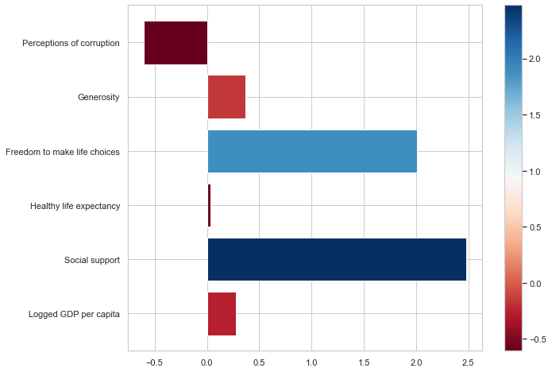
ML Linear Regression modeling gave us the importance of each of the 6 factors
Very surprisingly, we can see that the main two deterministic factors in calculating the Happiness levels are in fact Freedom and Social Support.
The third most important is Corruption, negatively correlated.
GDA per capita has an even lower importance than Generosity, and its absolute importance is only higher than Life Expectancy.

Slide 7
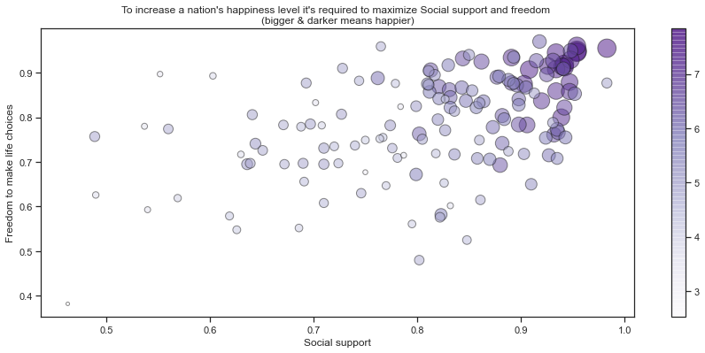
The 2 factors that matter

Slide 8
Conclusion - is it us or them who hold the key to happiness?
Money is a factor in overall population happiness. But so are Freedom, Social Support, Corruption, Generosity and Life Expectancy.
And while there are obvious correlations demonstrated here, it’s hard to determine the causality, so say with maximum confidence that one of this factors are absolutety causing happiness and not the other way around: an increased level of happiness determines a higher level of Generosity, for example.
So while there’s still work to do and exploration to be conducted, we can confidently say based on our short research that the political class and the leadership of a nation through the measures imposed and adopted are having a very high impact on overall national happiness.
More precisely, people are not so much happier when they are accumulating loads of wealth, but rather when they receive Social support and have the Freedom to make life choices.

Slide 9



Thank you!
This Photo by Unknown Author is licensed under CC BY-SA

